Slide 1

Global challenges 2022: Implications for SMEs and ECAs Post-covid production reconfiguration, geopolitical factors, supply chain disruptions and commodity prices
Berne Union
SME Specialist Meeting
Belgrade, September 28, 2022
Kori Udovički, PhD – Chairwoman, CEVES

Slide 2
What I will say today:
I The ongoing reconfiguration of global production...
started before the pandemic (factors)
the pandemic intensified it...
and probably offers more opportunities than risks for SMEs.
II The Russo-Ukrainian war...
exacerbated threat of recession
underscores importance of green transition
likely to impact SMEs less than large companies.
III Policy implications:
Efforts to internationalize SMEs should be redoubled…
with much greater focus on understanding factors of supply

Slide 3
I - Reconfiguration of Global Production

Slide 4
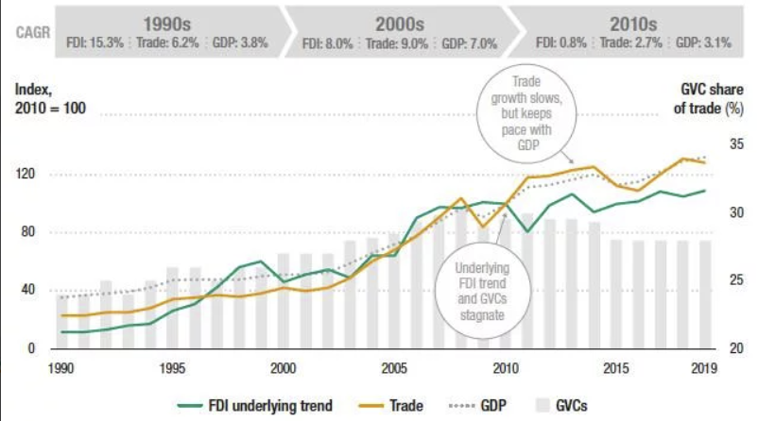
A reversal in globalization was probably already under way before the pandemic
For 2 decades, globalization advanced
Since GFC, FDI and trade have only kept pace with GDP
(Share of GVC in trade - stagnant or declining)
Share of SMEs in exports of 32 countries, 2008-2019 (OECD data)
Increased from 37% to 43% on average
22 countries increasing trend, 10 declining
Graph 1: The long-term trend of international production
Source: UNCTAD World Investment Report, taken from Center for Economic Policy Research (CEPR)

Slide 5
The very drivers of globalization now may foster its reversal
Technological change…
…at first unambiguously led to decentralization of production (value chains replaced of factories)...
- digitalization (remote communication and process control, separation of services from production process)
...but its further progress reinforced „reshoring“ potential
- advanced robotics: strong reason for reshoring
- additive manufacturing: potentially „mass customization“
- bio- and other- technologies: hard to tell
Wage differentials and growing productive capacity in outsourcing destinations...
…worked to increase the geographic spread of GVC...
...now the differentials are shrinking.

Slide 6
Lessons from the pandemic are a mixed bag
Pandemic underscored the importance of resilience v. efficiency – leading to efforts to:
de-risk value chains with largely re-centralizing effects
Shortening VC length
Re- /Near- shoring (reducing distance)
Greater transparency of VC (digitalization)
and other processes likely to encourage production dispersion
Diversification of suppliers
Digitalization (greater flexibility of work organization)

Slide 7
So far mindsets seem to have changed more than flows
First the global financial crisis showed the fallibility of markets
=> opened door for more intervention (World Bank now supports industrial policy!)
Then geopolitics provided a new impetus
More protectionism – US-China Trade war, EU-back to industrial policy
Regional, bilateral and ad hoc trade agreements
But so far both FDI and trade have more than recovered--now stand above pre-pandemic levels
Decreased container shipping costs and the ongoing improvement of technologies continue to favor long-distance trade (during pandemic trade traversed longer distances!)
Note: changes in the trade structure caused by the pandemic in a single year was similar to changes typically seen over 4-5 years

Slide 8

Expected mid-to-long- term outcomes
Shortening of value chains and increased concentration of production
Shrinking pool of efficiency seeking FDI (tougher competition to attract them)
Strengthening of regional markets and clustering
Diversification (opportunity) especially at the regional level
Smaller-scale and flexibility favored
Value chains increasingly rely on digital infrastructure and platforms

Slide 9
Impact on SMEs: probably more opportunities than risks
Shortening of value chains:
- Supplies produced in smaller series more likely to be „reshored“
- esp. if 3D-printing reduces need for outsourcing of customization
Regionalization
+ Smaller distances and series / clustering work in favor of SMEs
Diversification
+ Doors open where it may not have been expected (a stretch)
Smaller-scale and flexibility
+ Self-evident
Reliance on digital infrastructure
- Platforms themselves (very) large
+ May favor bottom-up access to GVC

Slide 10
II -The Russo-Ukrainian War

Slide 11
In the shorter run, Russo-Ukranian war is contributing to supply challenges, inflation, (recession?)
Skyrocketing energy and other commodity prices
Graph 2: Primary commodities prices indices – 2011-2022 m7
Source: IMF

Slide 12
In the shorter run, Russo-Ukranian war contributing to supply challenges, inflation, (recession?)
Energy costs overall ↑ 90% (July 2022 - July 2021)
Gas prices skyrocketing, 5-10x increase (in Europe and Asia) on year before
=> Fertilizer prices ↑ 70%
=> Food prices ↑ 10%
Russia and Ukraine account for more than 25% of the world’s trade in wheat, 60% of global sunflower oil and 30% of global barley exports – delayed and partly will not be realized
Supply of strategic raw materials at risk
=> Aluminium, nickel, potash, palladium, vanadium

Slide 13
Commodity price: Impact on SMEs
All else equal, shocks will have a stronger impact on SMEs
Fewer resources to:
diversify inputs
change technologies
endure losses
Less bankable
SMEs will be particularly affected by food production cost squeeze
(while opportunities to fill gaps in cereal production favors larger producers)
But less by gas prices – affect sectors with few SMEs (cement, fertilizer)

Slide 14
III - Policy Implications

Slide 15
A moment of massive structural change is rife with both with risks and opportunities
Policy-makers attention is increasingly drawn towards a looming recession
But a massive change in supply-side risks and opportunities is under way -- evidenced in ongoing supply value chain disruptions
Changes in demand structure, eg. for increased digitization, electric vehicle production, online orders
increase in demand for chip production creating backlogs
increase in demand for transportation and shipping services, also backlogs
decline in demand for office space
Tech. changes and the greening imperative continuously offering opportunities
My opinion: a race to make up for 4 years of structural change is what is holding the bottom of the global economy from falling out

Slide 16
ECAs should care about encouraging the internationalization of SMEs
SMEs are key:
for spreading the benefits of economic growth
over 50% of business sector employment, over 40% of VA, and 30% of exports
for innovation
to seize some of the opportunities offered by new circumstances
to growing national (as opposed to domestic) private sector income
healthy political economies
SMEs benefit from internationalization
→ Only path to sufficient growth in most manufacturing sectors
→ Increases their access to technology and competitiveness

Slide 17
Policy matters to internationalization of SMEs
Graph 3: Direct SMEs Exports, share in total v. population size - EU member and accession countries, 2019
in line with hyperbolic fit
High outliers
Low outliers
Smaller countries tend to have a higher share of SMEs in exports
Outliers can be explained by structure and policy
Source: Eurostat

Slide 18

Rebalance policy efforts: from attraction of FDI towards more promotion of SMEs
Pool of efficiency seeking FDI is likely to shrink (assuming GVC reconfiguration as expected)
tighter competition to attract them likely to result in regional „race to the bottom“
Example: countries in the Western Balkans
Not about protection, or subsidies (mostly not allowed), but about fostering a knowledge- and supportive services-rich environment

Slide 19
Key: build knowledge on risks and opportunities for SMEs amid change in production structures
Greater knowledge facilitates:
=> targeted investment in supportive environment (building the right capacities)
=> less transaction costs in assessing risk
=> further reach and coverage
=> more pooling of risk.
Publicly supported gathering and (international) exchange of SME sectoral, business and tech intelligence would go a long way.
Large companies make decisions based on consultancy information. (We learn from them as well: eg. (AlixPartners) estimated: in 2021 automotive industry lost more than $200 billion due to semiconductor chip shortage;
SMEs cannot afford consultancies.
Resources need to be dedicated, accumulating experiential knowledge over time, esp. for developing countries (can learn from each other)

Slide 20
Thank you for your attention!
kori.udovicki@ceves.org.rs
office@ceves.org.rs

